Slide 1
SCANNING AND ENUMERATION

Slide 2
Topic highlights
Scanning
TCP communication
Scanning methodology
Scanning techniques
Scanning tools
Scanning beyond IDS

Slide 3
What is network scanning?
The main objective of network scanning:
To identify live hosts on network
To identify open and closed ports
To identify operating system information
To identify services running on a network
To identify running processes on a network
To identify vulnerabilities
Network scanning is the method of getting network information such as identification, host, port information and services by scanning networks and ports.

Slide 4
TCP and UDP
TCP is connection oriented- once a connection is established, data can be sent bidirectional
UDP is simpler, connectionless internet protocol. Multiple messages are sent as packets in chunks using UDP

Slide 5
TCP Handshake (Three way handshaking)
To establish a connection, a client has to send
A synchronization bit
An acknowledgment no.
Sequence no.
Server will send
Ack=seqno+1
Sequence no.
Client will send
Ack=seqno+1
Same acknowledgment number will be sent as sequence no.

Slide 6
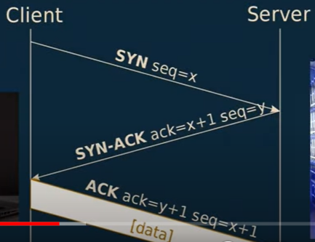
TCP CONNECTION

Slide 7
TCP Connection
It will contain information about data
Which service is running on which port: Can be identified using Port number.
Netstat –ano
IP Address: Port no
We can check the port number through task manager

Slide 8
Wireshark
To identify internet traffic: Incoming and Outgoing
Capture the network traffic
Stop and start capturing network traffic
Search packet for any specific protocol: TCP and UDP
For TCP Handshaking : [SYN] [SYN, ACK] [ACK]

Slide 9
Challenge
Open Wireshark
Show any example of three-way handshaking

Slide 10
Searching in Wireshark
Search for protocols
tcp contains (website name)
Frame contains “UMS”
ip.addr == 174.21.224.184
Conversation filters
tcp.ports == 443

Slide 11
Continue..
tcp contains username
tcp contains uid
tcp contains password

Slide 12
Challenge
Find out a TCP three-way handshaking
Find out Client Hello and Server Hello messages

Slide 13
Challenge
Open Wireshark
Search for the protocol (TCP/UDP)
Find a specific IP address
Search for packets of some website
Conversation filter

Slide 14
Scanning methodology
Checking for live systems
Discovering open ports
Scanning beyond IDS
Banner grabbing
Scanning vulnerabilities
Network diagram

Slide 15
Network Scanning
Ping: To check the live system (Packet internet gopher)
ping www.megacorpone.com
If the target machine has a firewall enabled then the ping request will not accept, and we will not get the target address.
Ping: To check the live system (Packet internet gopher)
nslookup flipkart.com
Whatweb www.megacorpone.com

Slide 16
How to access Metasploit machine IP address
Go to Metasploit Framework
Enter the password
Enter ifconfig

Slide 17
Nmap: Network mapper
Nmap – help
Scan the entire range of the network – nmap –Pn 172.21.225.0
Scan for specific port – nmap –p80 172.21.225.0
Scan for multiple port – nmap –p20 21 172.21.225.0
To identify which port is open and which is close
If you will have an open port along with vulnerability then you can hack that port

Slide 18
To check Open Port
To check all open ports:
nmap -p0-65535 ipaddress
nmap -p- ipaddress
To check all the open ports of TCP – Nmap –sT ip address
To check all the open ports of UDP – Nmap –uT ip address
Sudo nmap –uT ipaddress

Slide 19
Searching in Metasploit
Search smb
Grep scanner search smb
Use auxiliary/scanner/smb/smb_ms17_010
Show options
Set RHOST ipaddress
Run
Grep exploit search smb

Slide 20
To get OS and Service information
To identify the version of the services on the target machine – nmap –sV ipaddress
To identify target machine’s OS – nmap –O ipaddress
Aggressive scan – nmap –A ipaddress
To get all OS and version information

Slide 21
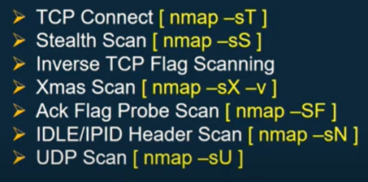
Scanning Types
To bypass IDS, IPS, and firewall: Stealth Scan (Syn, Ack+Syn packet will forward. The Last packet for ACK will not be forwarded, RST will be forwarded)
If we are doing scanning using TCP flag only like urgent, then Inverse TCP Flag scanning will use.
We will send only ack packet to victims machine: Ack Flag Prob Scan
Using a zombie machine to get ip address: IDLE/IPID Header Scan

Slide 22
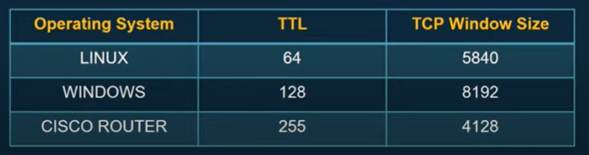
Continue..
Ping ipaddress : to find out ttl (Time to live) value
Nmap script : to identify the vulnerabilities.
Ls –l /usr/share/nmap/scripts

Slide 23
To identify scripts
SSH: to configure routers in a secure manner. To get the password for that router, we need to get ssh script.
Ls –l /usr/share/nmap/scripts |grep ssh : To find out only ssh script
Nmap –script=ssh-brute.nse ipaddress
If we have any default user name and password then we can attack over that machine.

Slide 24
Continue..
To identify DNS activity : Ls –l /usr/share/nmap/scripts |grep dns
Nmap –script=dns-check-zone.nse zonetransfer.me: That will give you information of all dns zone

Slide 25
Wireshark
Everything which you want to check: what's going on in-network using Wireshark
Sudo wireshark

Slide 26
Enumeration
Enumeration using Email-id
Enumeration using the default password
SNMP Enumeration
DNS Enumeration
NetBIOS Enumeration

Slide 27
Enumeration using default password
Enumeration is defined as a process of extracting user names, machine names, network resources, shared and services from a system.
Default user name and password can be accessed and the network could have been compromised.
cirt.net/passwords : All vendors who are preparing network devices, along with what password they are using.

Slide 28
SNMP Enumeration
Simple network management protocol is an internet standard protocol for collecting and organizing information about managed devices on IP networks and for modifying that information to change device behavior.
It also provides functionality to check network performance. It will give you the overall information of your network.

Slide 29
Continue..
The SNMP system is consisting of three elements:
SNMP Manager: They have all the network information. They will manage the network.
SNMP Agents: They will send the trap messages to the attacker
Management Information Base (MIB): It is an ASCII text, that has information on all devices that are on the network.

Slide 30
To configure SNMP
Control Panel\All Control Panel Items\Programs and Features\Simple Mail Network Protocol\Enable the same
Window+r – services.msc – go to snmp – add two community (Public (read only) and Private (read and write))
Go to agent and enable all services.
Msfconsole

Slide 31
Continue..
Msfconsole
Search snmp
Use auxiliary/scanner/snmp/snmp_enum
Show options
Set RHOSTS ipaddress
Exploit
You can get all the information from target machine

Slide 32
DNS Enumeration
DNS zone transfer is the process where a DNS server passes a copy of part of its database (which is called a “zone”) to another DNS server.
If you want to transfer information from one DNS server to another server, called DNS zone transfer.

Slide 33
Continue..
dnsenum zonetransfer.me : All information
host zonetransfer.me : Host information
host –t ns zonetransfer.me : Namespace server information
host -l ns zonetransfer.me nsztm2.digi.ninja : To get details of that particular nameserver
Nslookup zonetransfer.me

Slide 34
NetBIOS Enumeration
Network basic I/O System. It allows computer communication over a LAN and allows them to share files and printers.
NetBIOS names are used to identify network devices over TCP/IP
It must be unique on a network, limited to 16 characters where 15 characters are used for the device name and the 16th character is reserved for identifying the type of service running or name record type.

Slide 35
Continue..
Attackers use the NetBIOS enumeration to obtain:
List of computers that belong to a domain
List of shares on the individual host on the network
Policies and password
Nbtstat –a ipaddress: To find the target machine NetBIOS information

Slide 36
Email Foot printing
Email is one of the most professional and widely adapted professional way of communication that is used by every organization.
Tracing an email using an email header can reveal the following information:
Destination address
Sender’s IP address
Sender’s Mail server
Time and date information
Authentication system information of sender email server

Slide 37
ultratools.com
Open your email – Go to the spam folder
Open any spam mail – Click more – show original – search received from
You can get sender email along with ip address
Go to ultratools.com – IT tools – IPWHOS Lookup
Paste ip and click go
You can get all the information for that ip address

Slide 38
emailtrackerpro.com
Open emailtrackerpro.com
Emailtrackerpro – mytracereport – traceheader
Paste the detail over there. This will paste automatically.
It will give us all information related to sender
It will give us details like how many ips it has traversed.
It will give us location as well.
View report

Slide 39
Hardening
Right click on any folder - Go to property – Security – different role and permission – you can change the access right as per users’ role
Go to windows setting – update and security – Install Now.
Always check for windows update
Remove the features from Control Panel\All Control Panel Items\Programs and Features\ - If not required

Slide 40
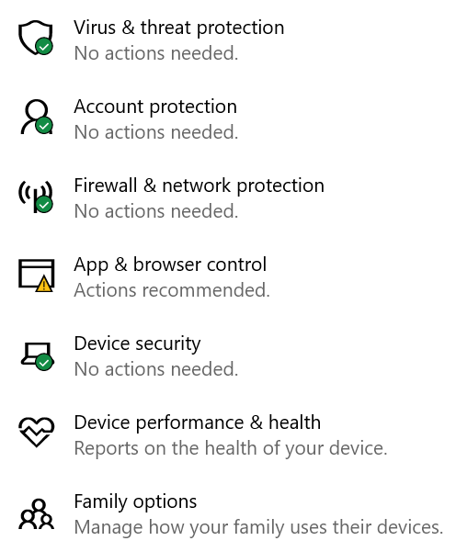
Windows Security

Slide 41
Search in Windows Security > AutoPlay > Turn this off
Search in Windows Security > Bluetooth > More Bluetooth Options > Do not allow blue tooth devices to automatically connect from your system

Slide 42
Windows Defender Hardening
Virus and Threat Protection > Turn on real-time protection
Windows Defender Firewall – To turn on protection

